Slide 1

2025 Benefits Information:
Prescription Benefits
Presented by
CVS Health
Notes:
Hello and Welcome to an overview of your Prescription Benefit

Slide 2

The CVS Caremark focus
2025 Prescription Benefits
Manages your prescription benefits like your health insurance company manages your health benefits
Works with the State of New Mexico to determine what medications are covered, what they will cost and
where prescriptions can be filled
Provides tools and services
to help you stay on track with your medications and take care of your health
©2023 CVS Health and/or one of its affiliates. Confidential and proprietary.
Image source: CVS Health Creative Resource Library, accessed 2021, 20200711_05_Livingroom_06905
Notes:
CVS Caremark works with the State of New Mexico to provide you with prescription benefits. This includes determining what medications are covered under your plan, how much you’ll pay for your medications, and where you can fill prescriptions. CVS Caremark also gives you tools and services to help you stay on track with your medications and take care of your health so you can live your best life.

Slide 3

Everything you need to manage your medications anytime, anywhere
2025 Prescription Benefits
Caremark.com and the
CVS Caremark app
  Review
  your plan
  details
Check medication costs and find
ways to save
Find in-network pharmacies or start delivery by mail
Order mail service refills and track shipments
View history of your prescriptions
Track progress toward your deductible or
out-of-pocket maximum
Set alerts and reminders to help you stay on track
Once you’re registered, download the CVS Caremark app from your preferred app store
to manage your medications on your smart phone
©2023 CVS Health and/or one of its affiliates. Confidential and proprietary.
Image source: CVS Health Creative Resource Library, accessed 2021, 20200820_18_Media_Room_009394
Notes:
Caremark.com makes it easy for you to manage your medications from your desktop or smart device. Once you register, you can review your specific plan details, see how much your medications will cost and find ways to save, find pharmacies in your plan’s network, refill your mail service prescriptions, view your prescription history, and see your progress toward meeting your individual or family maximum. You can also set up alerts and reminders to help you stay on track.

Slide 4

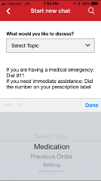
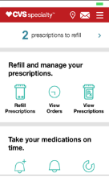
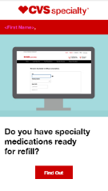


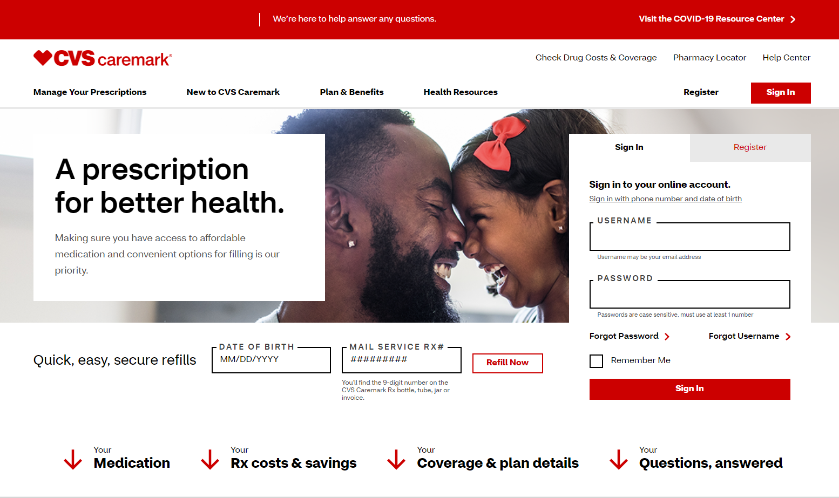
Tools help members get what they need, when they need it
Connections to care
Secure messaging
Connected glucose meters
MinuteClinic hold-my-place-in-line app
MinuteClinic video visits
Secure messaging
1-on-1 CareTeam support where and when patients need it
Mobile app
Manage refills,
set reminders
Secure email
Track orders,
refill reminders
Convenience, savings and ease of use
Mobile prescription pick up and pay
Two-way text
Scan to refill
Refill text reminders
Benefit access and transparency
Real-time benefits information through EHR
Check drug cost and coverage
Early registration at Caremark.com
to provide access before effective date
Website
Condition education, registration, refills, payments, account management
54266
Image source: CVS Health Creative Resource Library, accessed 2019.
Notes:
To help simplify and enhance your experience, we present relevant, contextual information to members where they live and work in a digital world through tools like text, email, web, mobile web, apps, and wearables. Here you can see a small subset of the high-level features, tools and benefits we offer. We’ve built this ecosystem so that that you can manage your prescription needs and connect to care – when, where and how you want to do it. Our digital tools provide three key benefits for you:
Connections to care
Convenience, through savings and ease of use
Access to benefit information
Tools like secure messaging, wearables and connected meters enable clinical guidance grounded in the patient’s experience and biometric data, helping you better manage your condition, with support from your providers and care teams.
A great example of how we provide greater convenience for you is our guest refill, or scan-to-refill, where you can scan a bar code, and the tool uses optical recognition so you can refill a prescription without having to log in. With Savings Advisor, you can see personalized Rx savings opportunities, either by going to your personalized page on Caremark.com that clearly lists all your savings opportunities, or by choosing to receive proactive email savings alerts – helping you find the most affordable drug options.
We provide a broad set of tools to help you get what you need – when and how you need it. This enables greater connections to care, convenience and access to benefits.

Slide 5

2025 Prescription Benefits
The Affordable Care Act (ACA) Preventive Services Drug List includes:
Certain medications, supplements or products to:
  Prevent certain health conditions
  Help you quit smoking or using tobacco
  Prepare for certain health screenings in adults
Vaccines and immunizations to prevent certain illnesses in infants, children and adults
Contraceptives for women
ACA Preventive Services Drug List
For some medications, you pay $0 even if you or your family haven’t met your annual deductible
Find the full list at Caremark.com
©2023 CVS Health and/or one of its affiliates. Confidential and proprietary
Please note: Your exact benefits may vary – see your benefits materials for details
Image source: CVS Health Creative Resource Library, accessed 2021. A_RoyaltyFree_0352. Asset ID: 253511. No expiration.
Notes:
The ACA preventive services drug list includes medications and other products that are used to prevent or manage certain health conditions, help you quit smoking, or prepare for certain health screenings. It also includes certain vaccines and contraceptives for women. If you fill a prescription for one of these medications, you’ll pay $0. You can see the full list at Caremark.com.

Slide 6


Formulary
Also know as a
Preferred Drug List (PDL)
Formulary principles
Maintain the highest
clinical integrity
Secure competitive pricing
Support members
+
Purpose: to ensure that drugs covered by your plan are safe, effective, and available at a reasonable cost.
Formulary Categories/ Tiers
Generic Medications
Preferred Brand Medications
Non-Preferred Brand Medications
Notes:
Your pharmacy Benefit plan utilizes a Formulary, also know as a preferred drug list. A formulary is a list of prescription drugs that are covered by your plan. The purpose of the formulary is to ensure that drugs covered by your plan are safe, effective, and available at a reasonable cost.
Medication on the Formulary are separated into 3 categories or Tiers.
Tier 1- is Generic medications ǀ Have the same active ingredients as the brand-name medication and are approved by the U.S. Food and Drug Administration (FDA); These are usually your lowest-cost option
Tier 2- is Preferred brand medications ǀ Are Brand Medications that are typically at a lower-cost option
Tier 3- is Non-preferred brand medication ǀ Are Brand medications that are covered but at a Higher-cost option
Specialty medications have their own Formulary and are also divided into these three categories. Additionally, the State of New Mexico partners with PrudentRx to provide specialty medications. We will discuss PrudentRx more in just a moment.

Slide 7
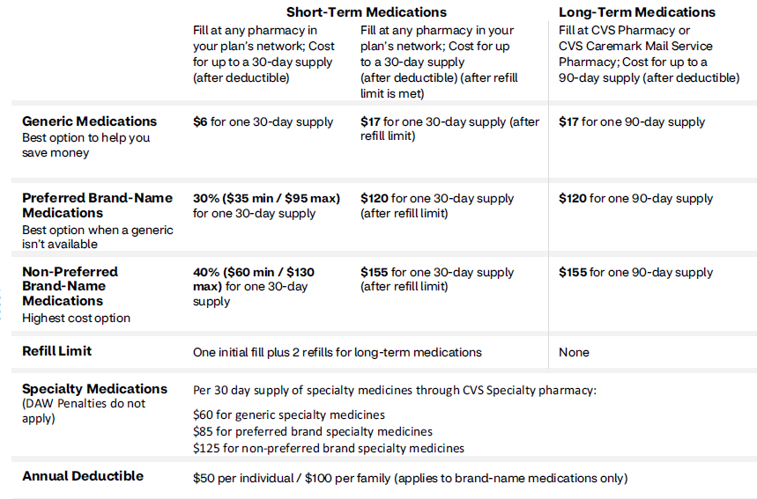
2024-2025 Prescription Benefits
Benefits at a Glance
©2023 CVS Health and/or one of its affiliates. Confidential and proprietary.
Notes:
This information provides a summary of your cost share.
Again, generic medications are the least expensive option, and we encourage you to speak with you provider about generic options, whenever possible. Filling a 90 day supply through mail order or an in network pharmacy will also provide a greater savings and convenience. WE encourage you to utilize the check drug cost tool on Caremark.com in order to find the lowest cost option for you.
Your plan also has a set maximum out of pocket limit that varies with each plan option. After reaching this maximum out of pocket limit, you will pay $0 out of pocket for covered medications.

Slide 8

Incentivized Mail Order
2025 Prescription Benefits
With Incentivized Mail Order, medications you take regularly (such as diabetes, asthma or high blood pressure medications) can be filled in 90-day supplies through CVS Mail Order Pharmacy.
90-day supplies are more convenient and usually cost less
If you fill prescriptions for medications taken regularly at retail pharmacies, or in 30-day supplies, you will have to pay a higher copay.
You have 3 fills of a medication at retail pharmacies or 30-day supplies: After which cost will increase to 90-day supply copays.
©2023 CVS Health and/or one of its affiliates. Confidential and proprietary.
Image source: CVS Health Creative Resource Library, accessed 2020, 20191113_07_pharmacy_shot_B_02622
Notes:
The Incentivized Mail order aims to decrease cost for members through encouraging members to fill long term medications at 90 day supplies through Mail order. Members may fill up to 3 times at retail pharmacies or in 30-day supplies. Members should then fill at 90-day supplies through mail order to receive increased savings.

Slide 9

CVS Specialty and
PrudentRx
Image source: CVS Health Creative Resource Library, accessed 2021, G-949464280. Asset ID: 421754. No restrictions

Slide 10

Pay $0 for specialty medications with PrudentRx
2025 Prescription Benefits
New Mexico is working with PrudentRx to reduce your
out-of-pocket costs for specialty medications to $0
Pay $0 for any medication on your plan’s Exclusive Specialty Drug List for as long as you’re enrolled – even if there is no copay program available
PrudentRx works with manufacturers to get copay assistance for your medications
PrudentRx handles all the details for you — no need to worry about renewals or expiration dates
Watch your mailbox for more information. PrudentRx will reach out to enroll members with eligible specialty medications. * You can choose to opt-out at any time. If you opt-out, you’ll have to pay 30 percent of the cost of your medication
*Some manufacturers require you to sign up to take advantage of the copay assistance that they provide for their medications – in that case, you must call PrudentRx to participate in the copay assistance for that medication. PrudentRx will also contact you if you are required to enroll in the copay assistance for any medication that you take. If you do not return their call, choose to opt out of the program, or if you do not affirmatively enroll in any copay assistance as required by a manufacturer, you will be responsible for 30 percent of the cost of your specialty medications.
©2023 CVS Health and/or one of its affiliates. Confidential and proprietary.
Image source: CVS Health Creative Resource Library, accessed 2021, G-73773763. Asset ID: 285465. No expiration.
Notes:
The State is working with PrudentRx to reduce your out-of-pocket costs for specialty medications to $0. If you are taking an eligible specialty medication, you will need to enroll if you have not already done so. Once we receive a claim for an eligible specialty medication, PrudentRx will reach out to begin enrollment. Once enrolled, you’ll pay $0 for as long as you participate in the program. Watch your mailbox for important information on the program and how to enroll. If you choose not to enroll, you’ll be responsible for 30% of the cost of your specialty medication.

Slide 11

Thank you
Legal disclaimers
Products that qualify as preventive services may be available at a lower cost share or no cost share, depending upon your plan, and may change from time to time. Please check your plan benefit materials should you have any questions about your coverage.
Flu shots and vaccines may not be available in all pharmacies at all times. Call for availability and to make an appointment, if needed. Most vaccines require a prescription (except for the flu shot). Contact your medical carrier directly to find what vaccine benefits are available at other medical facilities such as a doctor’s office, urgent care, etc.
Certain drug options identified above may be subject to additional prior authorizations or other plan design restrictions. Please consult your plan for further information.
Copayment, copay or coinsurance means the amount a plan member is required to pay for a prescription in accordance with a Plan, which may be a deductible, a percentage of the prescription price, a fixed amount or other charge, with the balance, if any, paid by a Plan.
This information is not a substitute for medical advice or treatment. Talk to your doctor or health care provider about this information and any health-related questions you have. CVS Caremark assumes no liability whatsoever for the information provided or for any diagnosis or treatment made as a result of this information. This document may contain references to brand-name prescription medications that are trademarks or registered trademarks of pharmaceutical manufacturers not affiliated with CVS Caremark.
Your privacy is important to us. Our employees are trained regarding the appropriate way to handle your private health information.
This presentation contains trademarks or registered trademarks of CVS Pharmacy, Inc. or one of its affiliates; it may also contain references to products that are trademarks or registered trademarks of entities not affiliated with CVS Health.
Accordant Health Services, LLC, is a CVS Caremark company. All rights reserved. Accordant Health Services, LLC is a wholly owned subsidiary of CVS Caremark. Our program, care team and care managers do not provide diagnostic services or direct treatment. We assist you in getting the care you need and our program is not a substitute for the medical diagnosis, treatment and/or instructions provided by your health care providers.
©2023 CVS Health and/or one of its affiliates. Confidential and proprietary .
Image source: CVS Health Creative Resource Library, accessed 2021, G-925163620. Asset: 244527. No expiration.
Notes:
Image source: CVS Health Creative Resource Library, accessed 2021, G-925163620. Asset: 244527. No expiration.

Slide 12
CVS Health policy statement
All CVS Health presentation materials are confidential and proprietary and may not be copied, distributed, captured, printed or transmitted (in any form) without the written consent/authorization of CVS Pharmacy, Inc.
©2023 CVS Health and/or one of its affiliates. Confidential and proprietary .

