Slide 1


An Introduction to Wellbeing-Solutions
Employee Assistance Program for the State of New Mexico

Slide 2
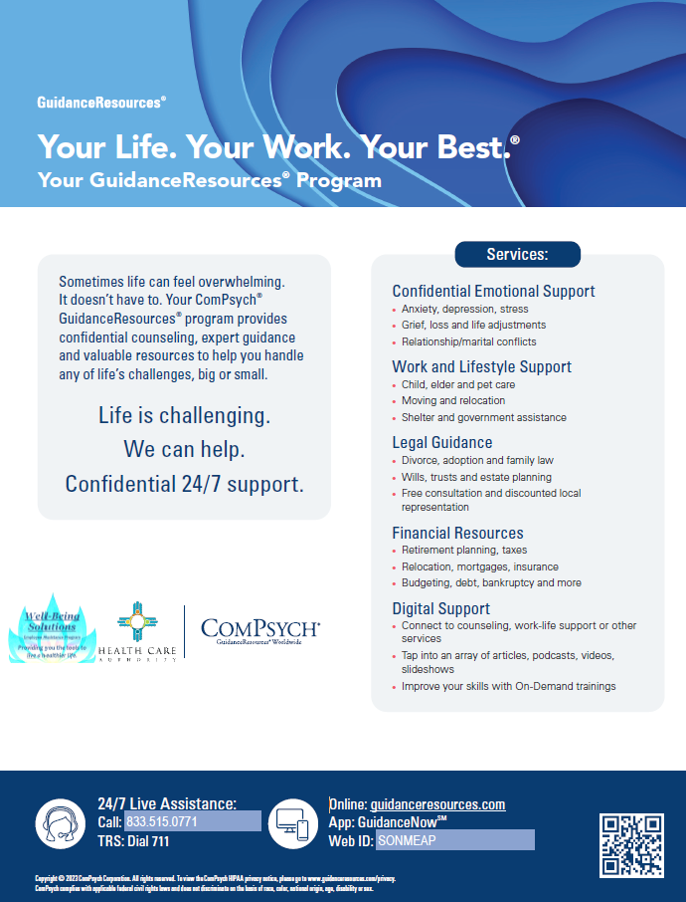
Program Model for SONM
No eligibility verification, available to all employees and household members. No cost, confidential.
24/7 multilingual access to master’s level clinicians
5 - Session counseling model per person, per issue, per year
Integrated unlimited work-life services, including:
FamilySource®
LegalConnect®
FinancialConnect®
GuidanceResources® Online / GuidanceNow SM App
Training & Wellbeing workshops available onsite or via webinar
Critical Incident Stress Management (CISM) support available onsite or via webinar

Slide 3

Confidentiality
The program is strictly confidential
Records are maintained by ComPsych®
Summary of number of requests for assistance

Slide 4

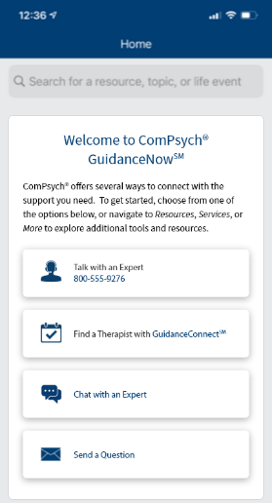

Available 24 Hours a Day
Call us anytime for solutions: 833-515-0771
Go Online: GuidanceResources.com
Company Web ID: SONMEAP
Download GuidanceNow APP

Slide 5

Confidential Counseling
Short-term Counseling – 5 sessions
Address issues early
No cost
Confidential
Voluntary
Long-term Counseling
Continuing treatment for long-standing issues
Refer to insurance

Slide 6



Integrated Work-Life
FamilySource®
Unlimited Support
Child care
Elder care
Education
Government programs
Health/wellness
Personal convenience
Moving/relocation
Customized referral packets; full research and availability checks
Work-life kits available (baby, wellness, retirement, etc.)
Online content and training resources
LegalConnect®
Unlimited consultation with
in-house attorneys
Family law
ID theft
Custody
Real estate
Contracts
Tax questions
Local referrals
In-person consultation
Discounted legal fees
Online content and training resources
FinancialConnect®
Unlimited consultation with in-house financial experts
Budgeting
Debt
Credit
Tax issues
Retirement planning
Real estate
Estate planning
Saving for college
Online content and training resources

Slide 7
Work-Life Services in Action
Online
SQL coding classes
Research for
the difference between symptoms
of Musical Ear Syndrome and Alzheimer’s Disease
Grants or scholarships
for prep
school
Social
activities for
55+ Christian
singles
Pick-up
service for furniture donation
Private investigator with IT expertise
who can help with online harassment and fraudulent social media accounts.
Mini-golf vacations that include senior special rates
Local dentist who can accommodate adults with special needs
Local acupuncturist and Reiki practitioners
Local pet chiropractor
for older
rescue dog
with arthritis
Beachside home
in the Hamptons
with a pool, access to bike trails and vegetarian-friendly restaurants
Service to
move mobile home in rural Louisiana

Slide 8
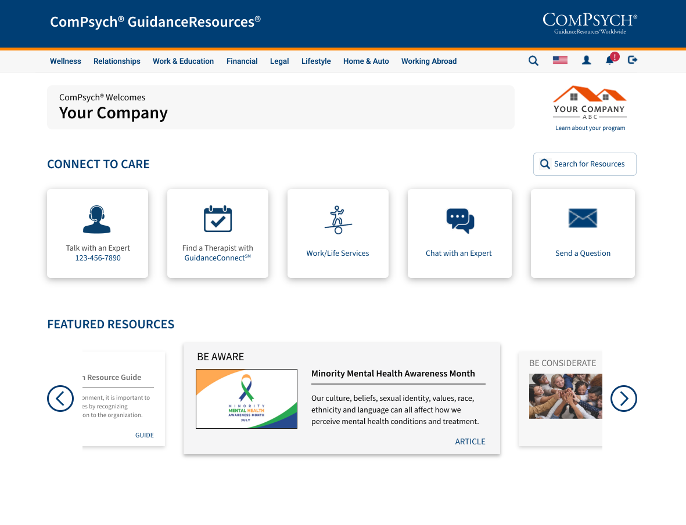








Digital Platforms
  GuidanceResources Online & GuidanceNow Mobile App
24-hour access to localized resources for 80 countries
On-demand training modules available anytime
Digital intake and referral for counseling and work-life needs
Special topic centers for individuals facing similar issues
Click to chat or send message to a master’s-level clinician
Lookup local child/ elder care, attorneys, financial experts
Content is organized by life event to reflect common searches
Discounts through partners for commonly used services

Slide 9
Questions and Discussion

