Slide 1
2025 Benefits Information: Dental
Presented by Delta Dental of New Mexico

Slide 2
Your Delta Dental Benefits Overview
Calendar Year Deductibles
$50.00 per enrolled person
$150.00 total per family
Deductible does not apply to Diagnostic & Preventive Services or Orthodontic Services
Benefit Annual Maximum - Calendar Year
$1,750 per enrolled person per calendar year
Orthodontic Lifetime Maximum
Children – up to 18th birthday
Plan Pays 75%, up to a $2,000 lifetime maximum
Adults – age 18 and over
Plan Pays 60%, up to a $1,750 lifetime maximum

Slide 3
Your Delta Dental Benefits Overview
 | In-Network Delta Dental PPO™ or Premier® Network |  | Out-of-Network
Diagnostic and Preventive Services – No Deductible
Covered - Oral Evaluations & Cleanings (2 per Calendar Year*), Radiographic Images, Topical Fluoride, Emergency Treatment, Sealants, Space Maintainers, and Diagnostic Costs | Delta Dental Pays: 100% | You Pay: 0% | Delta Dental pays 100% up to fee allowable; You pay any amount over allowable fee
Basic Services – Deductible Applies
Fillings, Stainless Steel Crowns, Extractions, Oral Surgery, Root Canals, Periodontics, and General Anesthesia | Delta Dental Pays: 80% | You Pay: 20% | Delta Dental pays 55% of fee allowable; You pay 45% plus any amount over allowable fee
Major Services – Deductible Applies
Onlays, Crowns, Bridges, Partials or Complete Dentures, Specified Implant Procedures | Delta Dental Pays: 60% | You Pay: 40% | Delta Dental pays 35% of fee allowable; You pay 65% plus any amount over allowable fee
*Covers routine cleanings twice per year. Individuals with certain medical conditions may qualify for up to 2 additional cleanings.

Slide 4
Your Delta Dental Benefits Overview
Orthodontic Services (All Ages) No Deductible
Children, for treatment starting prior to 18th birthday | Adults, for treatment starting Age 18 and over
Plan Pays 75% up to a $2,000 lifetime maximum | Plan Pays 60% up to a $1,750 lifetime maximum
For Out-of-Network providers, the benefits for children, plan pay 50%; for adults, plan pays 60% of the lifetime maximum.

Slide 5
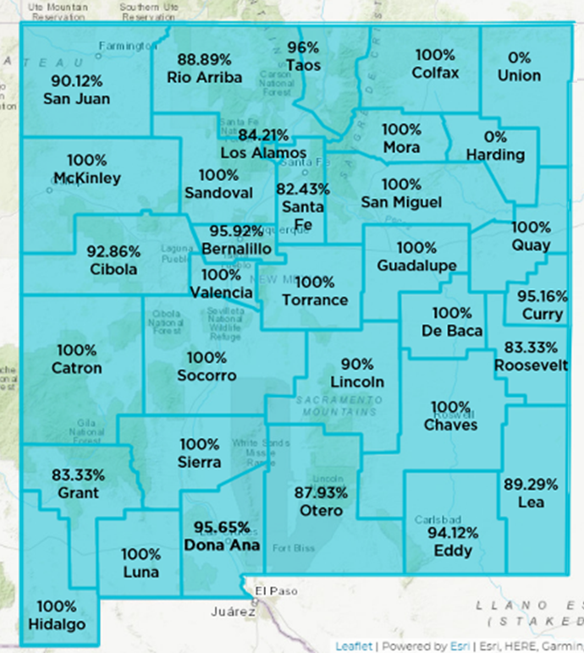
Delta Dental of New Mexico – Provider Network
Great In-Network Dental Provider Options for Our Members!
91% or 879 of the 965 practicing New Mexico Dental Providers participate in Delta Dental NM Networks
Over 152,000 dental providers nation-wide through our Delta Dental Provider Network
Your Delta Dental Networks are great in areas such as Las Cruces/El Paso, Farmington/Durango, & Roswell/Lubbock
Great Access to Affordable Quality Dental Services!
*Image depicts Provider Network Penetration by New Mexico county

Slide 6
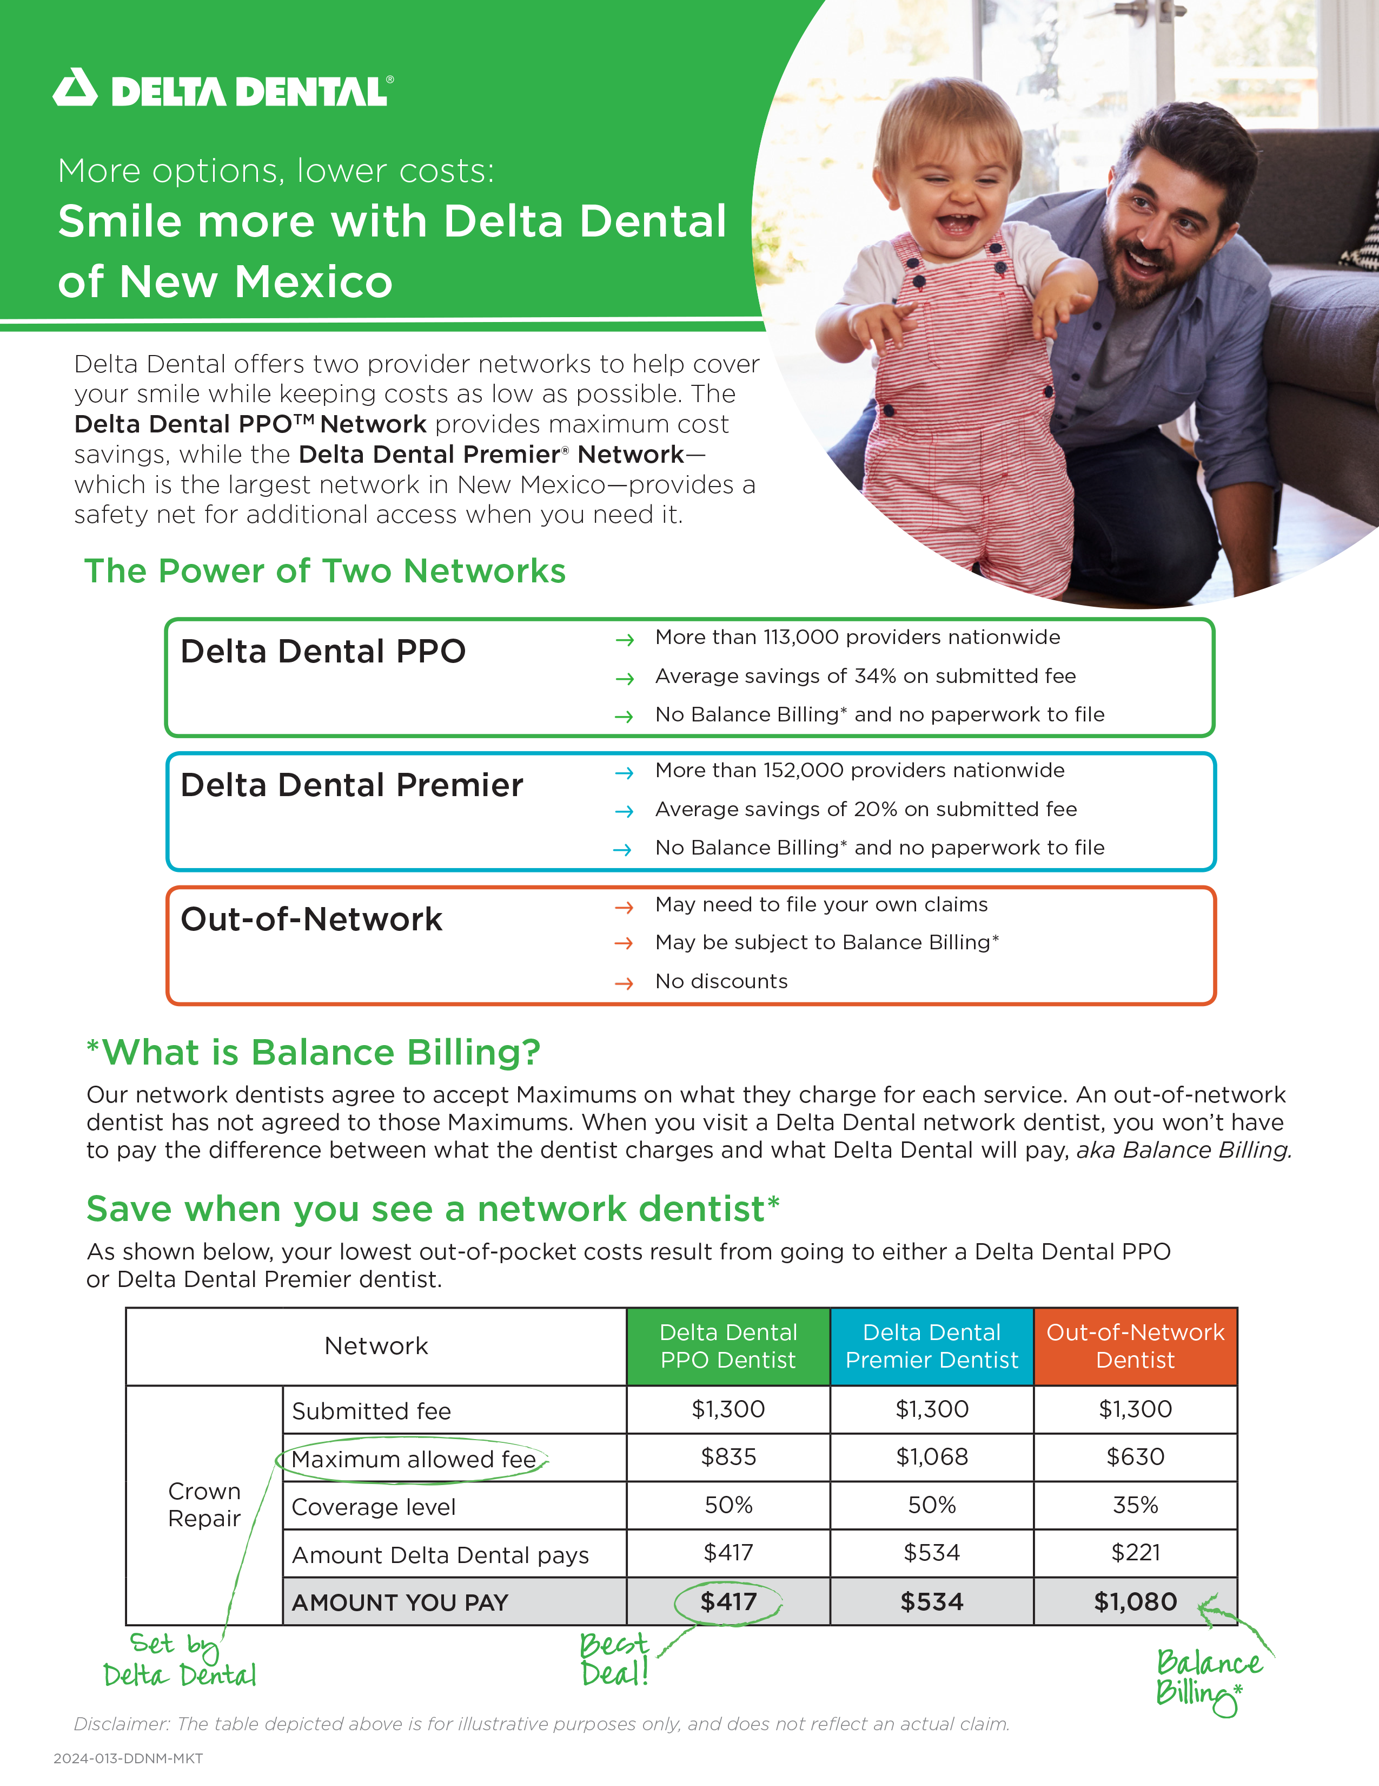
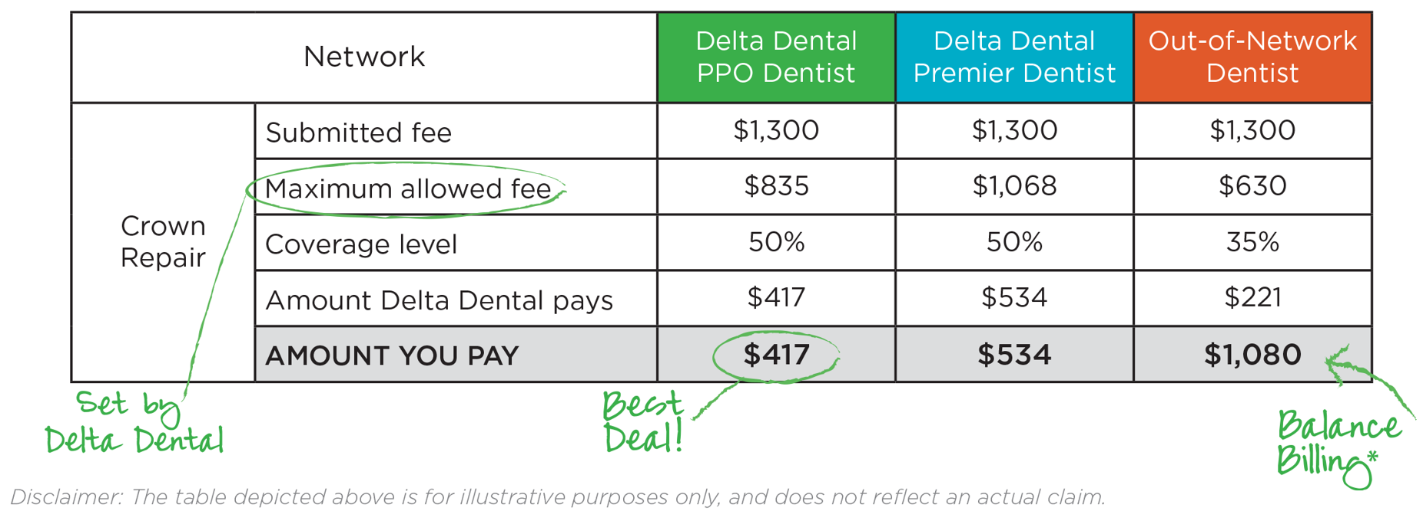
Delta Dental of New Mexico – Provider Network
Delta Dental of New Mexico offers TWO provider networks to help cover your smile while keeping costs as low as possible.
The Delta Dental PPO™ Network provides maximum cost savings, while the Delta Dental Premier® Network—which is the largest network in New Mexico—provides a safety net for additional access when you need it.
When you see an in-network provider, you’ll get the lowest out-of-pocket costs.

Slide 7
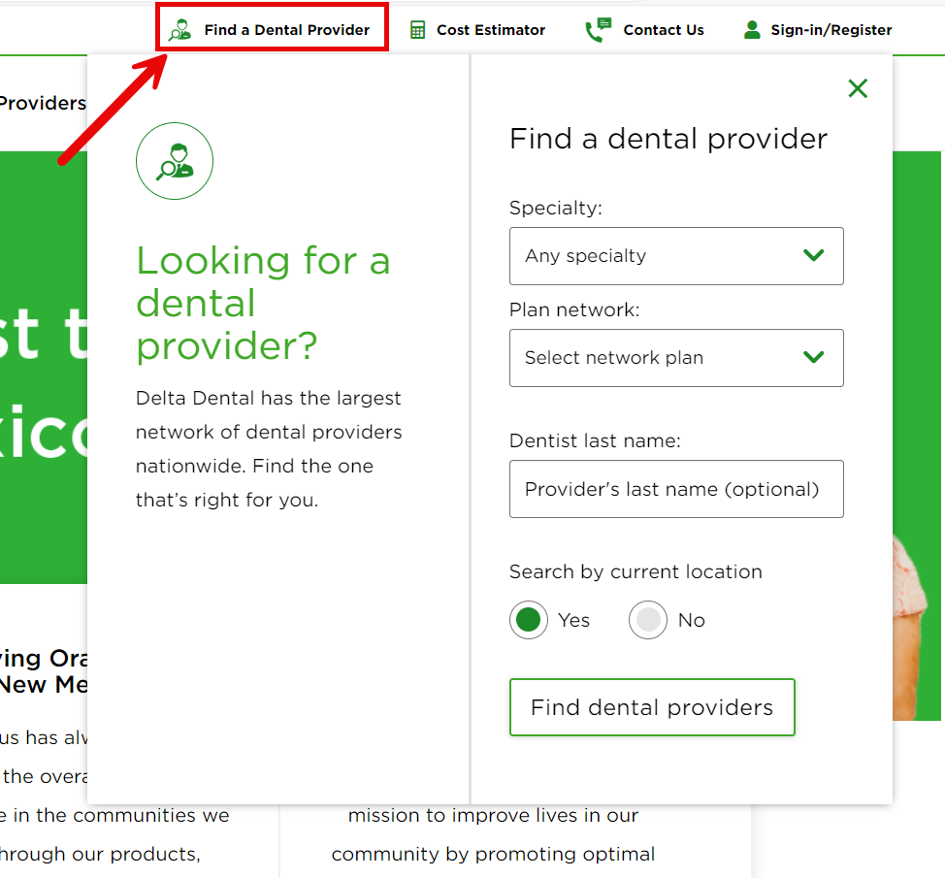
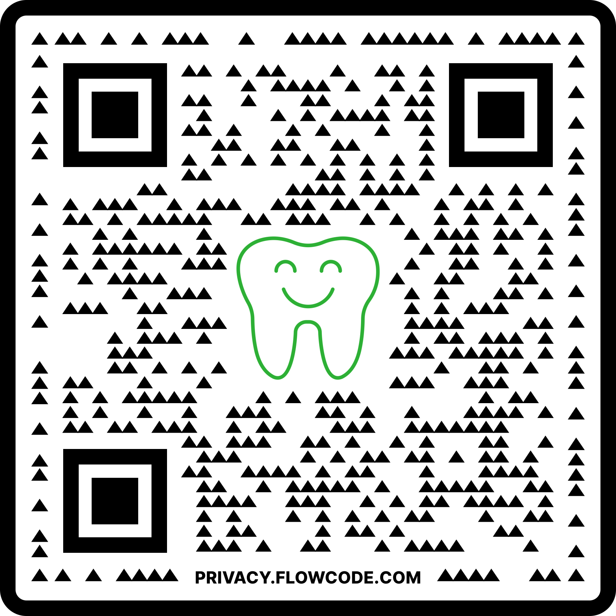
Finding an In-Network Dental Provider
On the Web It’s easy to find a Delta Dental dentist near you with our provider search tool:
Go to: www.DeltaDentalNM.com/tools/find-a-provider.com or click the “Find a Dental Provider” button located on the top of every page on our website.
Choose a Specialty and your Plan network from the drop-down menus
In the Search By Current Location question, choose Yes or No
Yes – The tool will use your location data from your web browser to give you a list of nearby dental providers
No – You’ll need to enter the zip code to search within to get a list of nearby dental providers
Click Find Dental Providers to see a list of nearby dental providers meeting your search criteria
On the Phone You can also find a dentist 24/7 through our automated phone system by calling us at (505) 855-7111 or (877) 395-9420
Or Scan the QR Code to Find a Dental Provider Near You Now!

Slide 8
Your Pre-Treatment Estimate of Benefits
ASK YOUR DENTIST FOR A PRE-TREATMENT ESTIMATE When costly procedures are anticipated, know what your share of the costs will be!
An advance estimate of benefits before dental care services are received
Make sure to get your pre-treatment estimate in writing (mail or email) from Delta Dental so you know your out-of-pocket cost!
No charge for a pre-treatment estimate!
You’re entitled to a pre-treatment estimate!

Slide 9
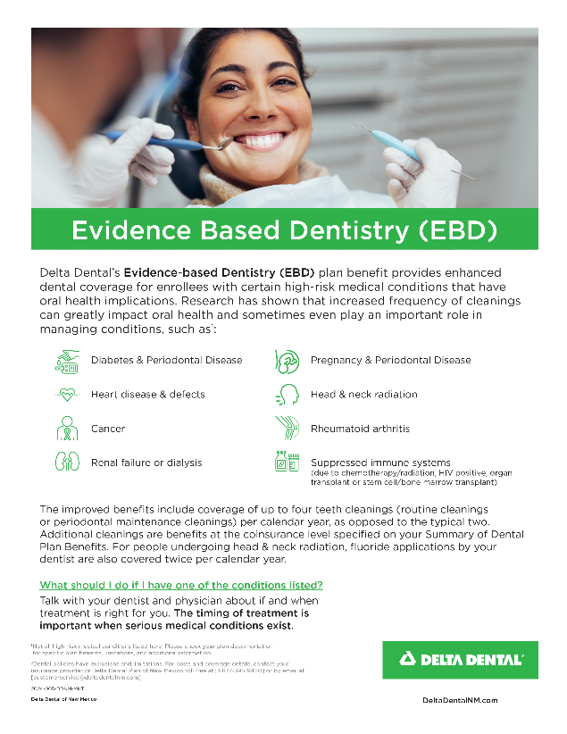
Your Delta Dental Evidence Based Dentistry (EBD)
Evidence Based Dentistry
Provides members with specified medical conditions may be eligible for additional cleanings (up to 4 total a year) or fluoride treatment.
People with diabetes AND periodontal (gum) disease
Women who are pregnant AND have periodontal (gum) disease
People with certain heart conditions that put them at high or moderate risk for infective endocarditis, a potentially deadly heart infection
People with kidney failure or who are undergoing dialysis
People with suppressed immune systems due to chemotherapy and/or radiation treatment, HIV positive status, organ transplant, and/or stem cell (bone marrow) transplant
Talk with your Provider if you qualify under one of these medical conditions. They will include the required documentation with the claim submission.
You’re entitled to a pre-treatment estimate!

Slide 10
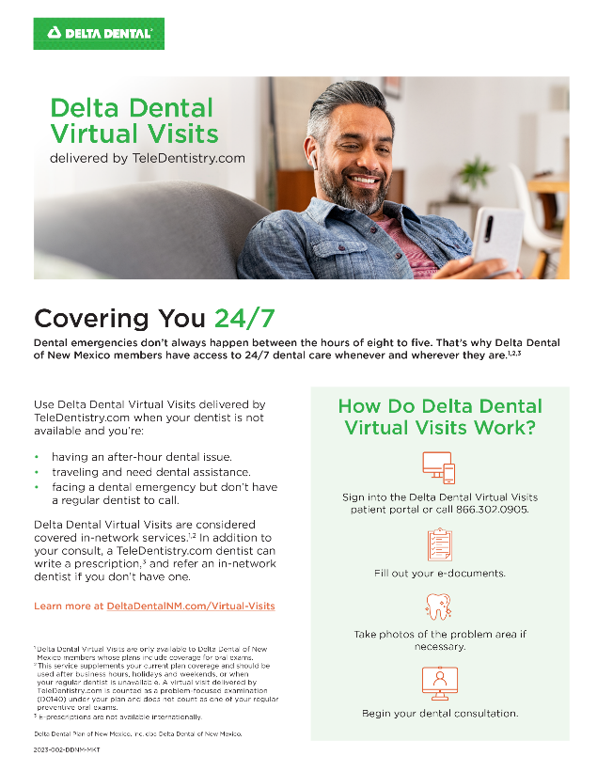
Your Delta Dental of New Mexico Teledentistry
Emergencies happen at the most inconvenient times, like when you're traveling and don't have access to your regular dentist. With your Delta Dental of New Mexico coverage, you and your family can rest assured that you have protection for dental emergencies. Access to Delta Dental Virtual Visits is a covered benefit in most of our dental plans.
24/7 Access to Licensed Providers
Emergency or Urgent Evaluations
Improves Rural Access
Access to Prescription Medication if needed
Facilitates Scheduling & Planning of Appointments
Promotes Utilization & Oral Health
Referrals to in-person Delta Dental Providers for Lowest Out-of-Pocket Costs
Learn more at www.DeltaDentalNM.com/Virtual-Visits.com

Slide 11
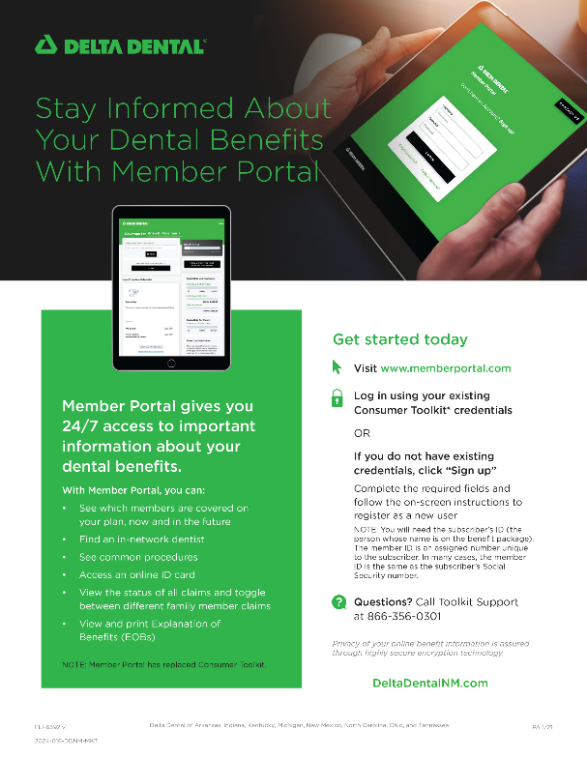
Your Delta Dental of New Mexico Member Portal
The Delta Dental Online Member Portal provides easy access to the following:
Find a Dentist Online
View & Print ID Card
View Claims & Pre-Treatment Estimates
View Benefits
Educational Materials, Reminders, Tips, & More!
Learn more at www.MemberPortal.com

Slide 12
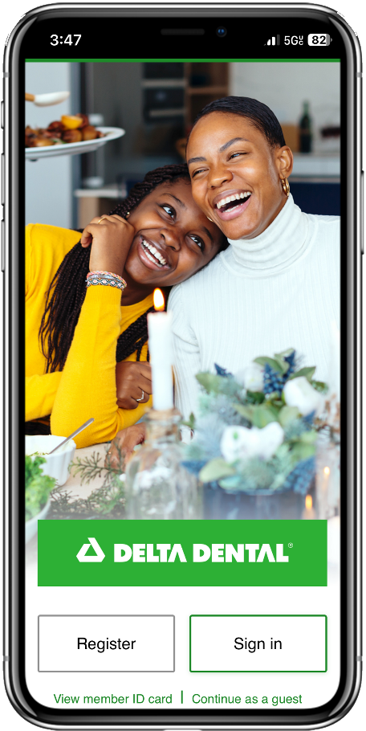
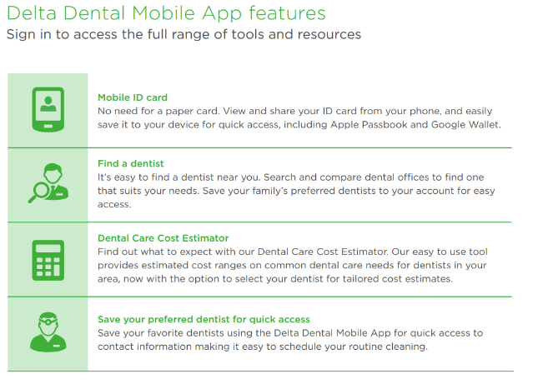
Your Delta Dental of New Mexico Mobile App

Slide 13
Your Delta Dental of New Mexico Customer Service
Call our Local Delta Dental Customer Service Team at (877) 395-9420
Customer Service is available Monday – Friday 8:00 AM - 4:30 PM (MST)
For 24/7 account information, call us at (877) 395-9420
Email us at: customerservice@deltadentalnm.com. Get a response in writing!
Once enrolled, go to the online Member Portal at www.deltadentalnm.com to access your account information 24/7. Find a dentist, view/print your ID card and much more!

Slide 14
Your Delta Dental of New Mexico Reminders
Remember, you can receive 2 Routine Cleanings/Exams in a Calendar Year. More than 120 signs and symptoms of non-dental diseases can be detected through a routine oral exam.
Stay in-network and find your local dentists by visiting www.deltadentalnm.com and search for a Delta Dental PPO™, or Delta Dental Premier® provider.
Remember to register with the online Member Portal once you are enrolled! Member Portal gives you 24/7 access to important information about your dental benefits.
Ask about your procedure before it is done! Don’t forget to ask for a pre-treatment estimate prior to dental services being performed. Reduce your out-of-pocket costs and know what is covered!

Slide 15
Thank you for your time.
We look forward to continuing to serving you.

