Slide 1


STATE OF New Mexico
All Benefit Eligible Members
of the State of New Mexico
and Local Public Body Agencies
Group Term Life and AD&D Insurance
Underwritten by Minnesota Life Insurance Company
Notes:
Hello. My name is _________ and I am here to talk to you about the life insurance options available to you as a State of New Mexico employee. Life insurance is underwritten by Minnesota Life Insurance Company, an affiliate of Securian Financial Group.

Slide 2
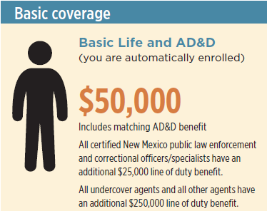

YOUR BASIC LIFE
INSURANCE COVERAGE
State employees are automatically enrolled in basic coverage. LPB employees check with your Human Resources office.
All basic coverage is employer paid.
Notes:
Group Term Life insurance provides a base level of protection that can be enhanced by personal savings, individual life insurance and Social Security benefits. This coverage will help protect your loved ones against the unexpected loss of your life and income during your working years.
All benefits eligible State of New Mexico employees and LPB’s that participate, are provided with $50,000 of Basic Term Life and Accidental Death and Dismemberment insurance. All certified New Mexico public law enforcement and correctional officers have an additional $25,000 line of duty benefit. Further, all undercover agents and all other agents have an additional $250,000 line of duty benefit. This coverage is employer paid.

Slide 3
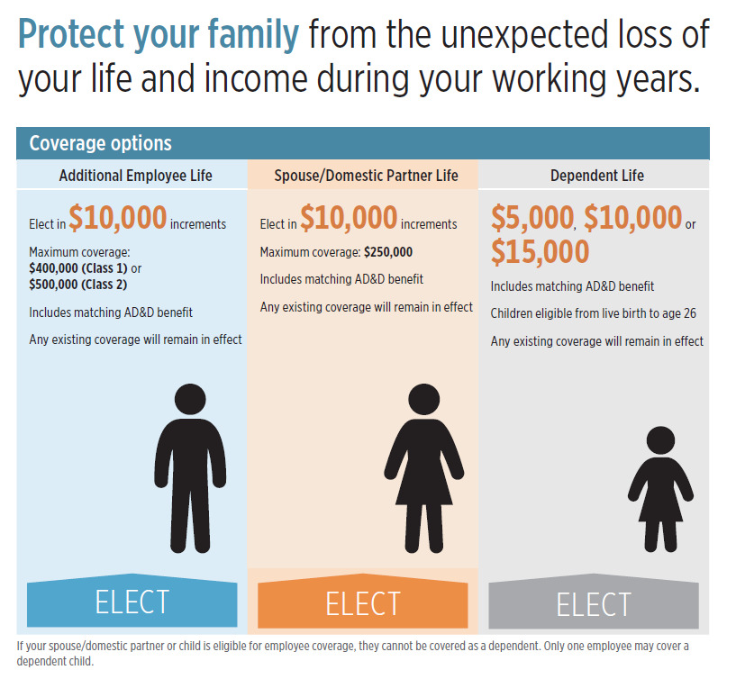
This coverage is effective January 1, 2017 and forward
Active legislator
Active member
Elect dependent coverage at any time without providing EOI
      This change regarding dual coverage was effective 1/1/2016. Anyone with dual coverage up-until December 31, 2015 will be grandfathered in.
Notes:
Beyond the Basic Term Life and AD&D coverage, you can elect additional coverage by purchasing Additional Employee Life, Spouse/Domestic Partner Life and Dependent Life coverage. Any coverage you elect during open enrollment will become effective 1/1/2018.
You can elect Additional Employee Life coverage in $10,000 increments up to a maximum of $400,000 if you are an active legislator, or up to $500,000 if you any other active member. This coverage includes a matching AD&D benefit.
You can elect Spouse/Domestic Partner Life coverage in increments of $10,000 to a maximum of $250,000 with matching AD&D. Spouse/Domestic Partner life insurance matters. You most likely have modest savings and big responsibilities – a mortgage, child care and other monthly bills. If your spouse dies prematurely, life insurance will help you maintain your home, current lifestyle and provide for your children’s support, now as well as in the future.
Finally, you can also elect Dependent Life in amounts of $5,000, $10,000 or $15,000. This coverage also includes a matching AD&D benefit. Children are eligible from live birth to age 26.
You can elect Spouse/Domestic Partner and Child life insurance coverages separately. If your spouse/domestic partner or child is eligible for employee coverage they cannot be covered as a dependent. EOI may be required for your Spouse/ Domestic Partner election. Only one employee may cover a dependent child.

Slide 4
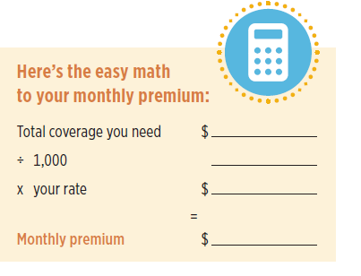
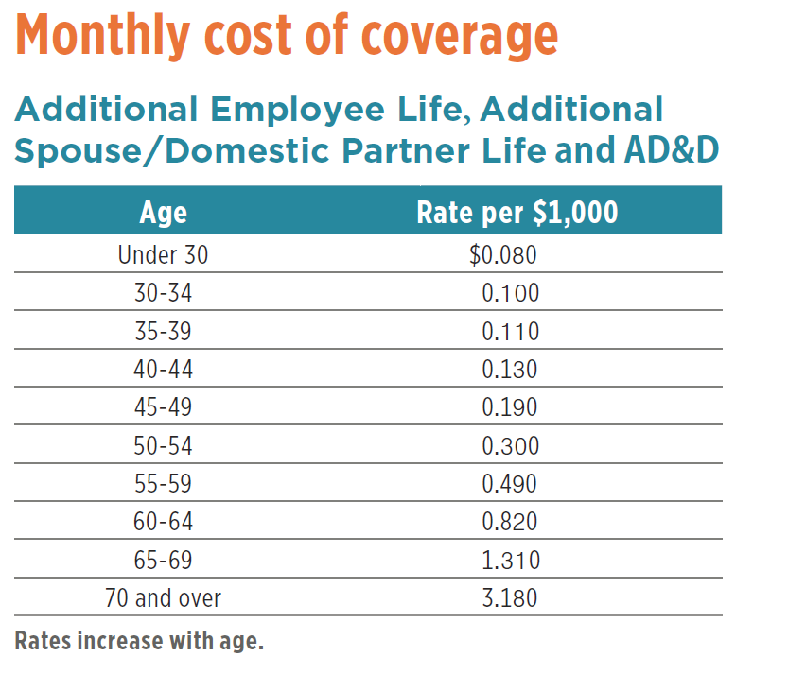

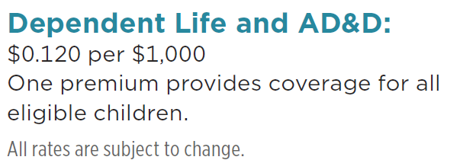
Notes:
Here you will see the cost of coverage for Additional Employee Life, Spouse/Domestic Partner Life and Dependent Life & AD&D coverage. A wonderful tool for determining the amount of life insurance you need is available. At any time, you can visit Lifebenefits.com/Insuranceneeds to use our insurance calculator.

Slide 5
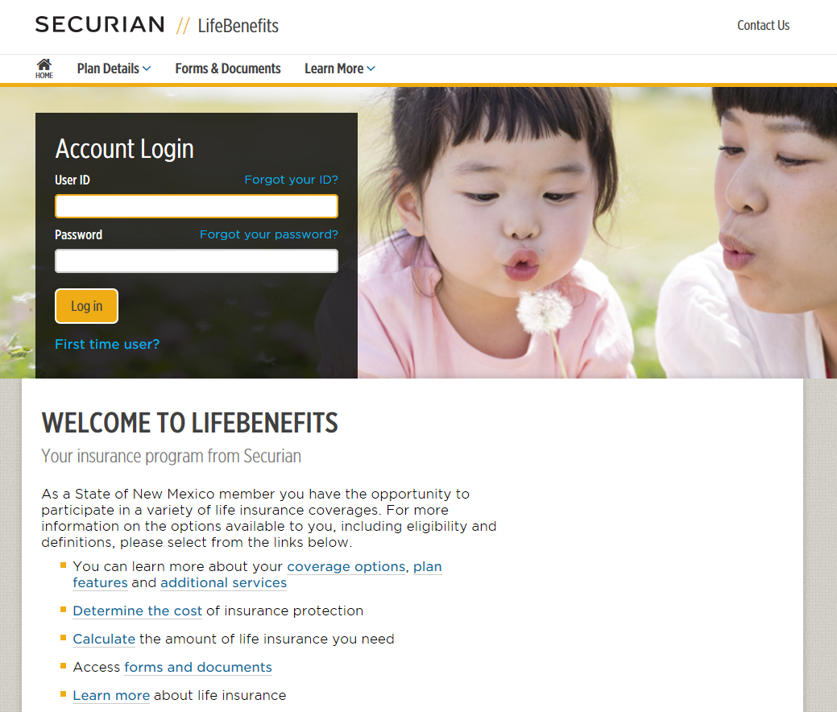
TO ENROLL OR NAME A BENEFICIARY, GO TO:
LifeBenefits.com/plandesign/SONM
Notes:
Go to Lifebenefits.com/plandesign/SONM and enroll!
**If you don’t enroll for new or different coverage your current coverage will continue as-is.***

Slide 6
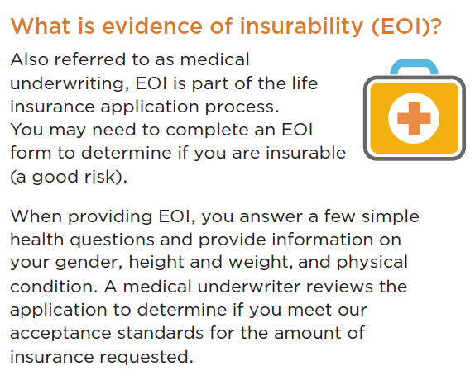
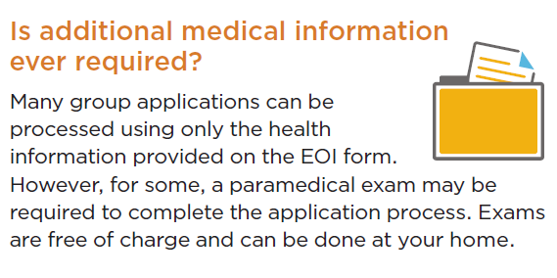
Notes:
When enrolling for coverage, you will need to complete Evidence of Insurability or (EOI), provided you are not a new hire.
Also referred to as medical underwriting, EOI is part of the life insurance application process. When providing EOI, you answer a few simple health questions and provide information on your gender, height and weight, and physical condition. A medical underwriter reviews the application to determine if you meet our acceptance standards for the amount of insurance requested.
Many group applications can be processed using only the health information provided on the EOI form. However, for some, a paramedical exam may be required to complete the application process. Exams are free of charge and can be done at your home.
You can complete EOI when you’re enrolling for coverage by going to LifeBenefits.com/PlanDesign/SONM. There you can walk through the online process or download the paper form.

Slide 7
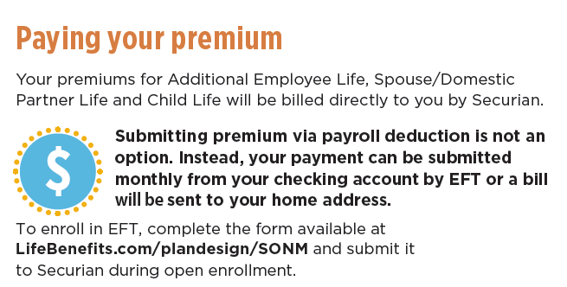
To Consider:
If you enroll for coverage, but do not enroll in EFT you will automatically receive paper invoices
The EFT option cannot be activated unless the account has a zero balance
If you enrolled in EFT last year, it will continue into 2018
Each paper bill has a $2.00 administrative fee
Paper billing does not allow for monthly billing. Paper invoices can be sent quarterly and semi- annually
Notes:
Please know your premiums for Additional Employee Life, Spouse/Domestic Partner Life and Child Life will be billed directly to you by Securian. Rather than paying the premium through payroll deduction, your payment can be submitted monthly from your checking account by EFT (Electronic Fund Transfer) or a bill will automatically be sent to your home address. If you want to enroll in EFT, complete the form available on LifeBenefits.com/plan design/SONM and submit it to Securian. The EFT option cannot be activated unless your account has a zero balance.
If you do not enroll in EFT you will automatically receive paper billing invoices. Each paper bill has a $2.00 administrative fee. You should also know, that paper billing does not allow for monthly billing. Paper invoices can be sent quarterly and semi- annually.
Remember, basic coverage will be paid for by your employer and you will not be billed for that coverage.

Slide 8
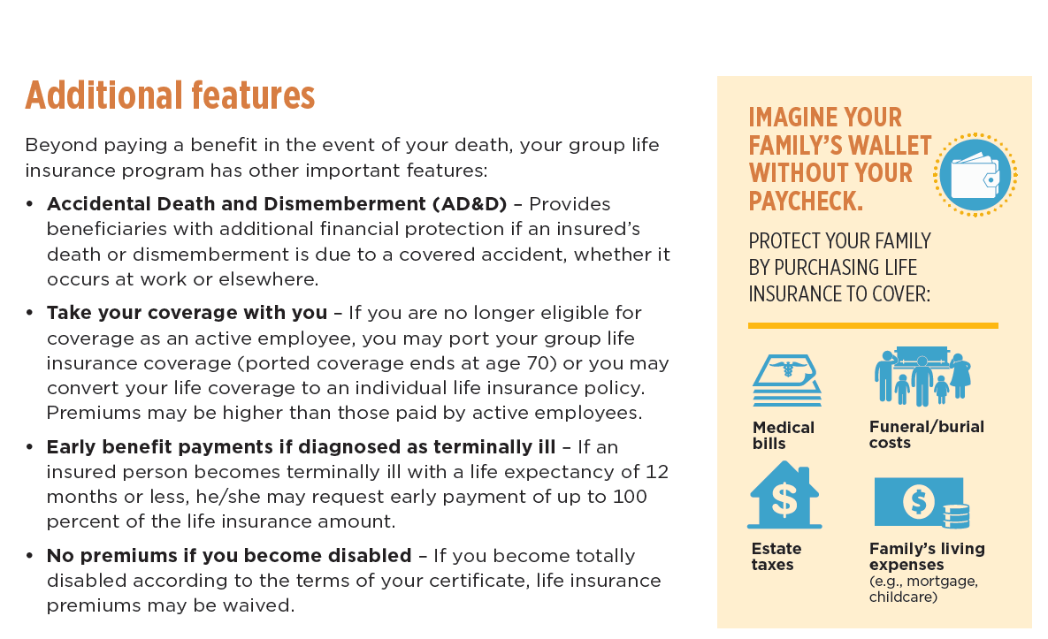

Notes:
Beyond paying a benefit in the event of your death, your group life insurance program has other important features:
• Accidental Death and Dismemberment (AD&D) – Provides beneficiaries with additional financial protection if an insured’s death or dismemberment is due to a covered accident, whether it occurs at work or elsewhere.
• Take your coverage with you – If you are no longer eligible for coverage as an active employee, you may port your group life insurance coverage (ported coverage ends at age 70) or you may convert your life coverage to an individual life insurance policy. Premiums may be higher than those paid by active employees.
• Early benefit payments if diagnosed as terminally ill – If an insured person becomes terminally ill with a life expectancy of 12 months or less, he/she may request early payment of up to 100 percent of the life insurance amount.
• No premiums if you become disabled – If you become totally disabled according to the terms of your certificate, life insurance premiums may be waived.

Slide 9

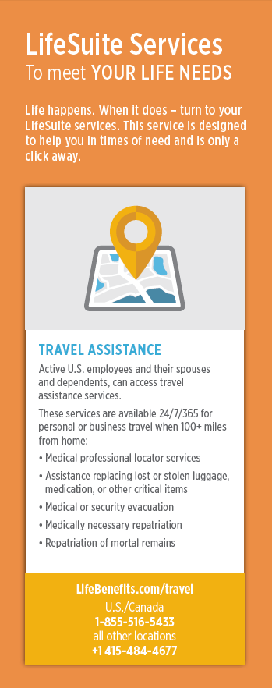

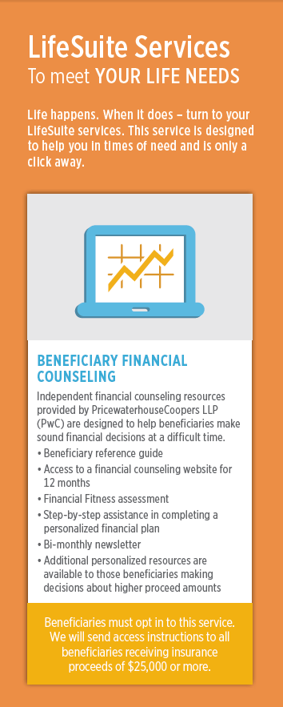
Notes:
LifeSuite Services: To meet YOUR LIFE NEEDS
Life happens. When it does – turn to your LifeSuite services.
As part of your new life insurance program you now have access to a suite of services designed to help you in times of need. The following services are available to you, your spouse/dp and your dependent children and there is no added cost to access these services. Feel free to use these resources as you need them.
Legal, Financial and Grief Resources –LifeWorks provides active employees covered under State of New Mexico’s group life insurance policies, and their spouses and dependents, access to unlimited telephonic guidance and consultation with legal, financial and grief professionals. Services also include comprehensive web and mobile resources and a 30-minute face-to-face consultation with an attorney for each unique legal issue. Both the financial and grief counselors at Ceridian are master’s level mental health counselors. To learn more about these resources, call 1-877-849-6034 or visit LifeWorks.com and log in with the username lfg and the password resources.
Travel Assistance Services – RedpointWTP LLC (Redpoint) offers comprehensive travel services, for personal or business travel, when 100 or more miles away from home to active employees and their dependents. Services include help locating medical and dental professionals, assistance replacing lost or stolen luggage, medication, or other critical items and dealing with identity theft while traveling. In the event that you face a serious illness or injury or find yourself in an unsafe place while on the road, Redpoint also provides medical and security evacuation. These services are available 24/7/365. For service terms and conditions, and pre-trip information visit LifeBenefits.com/travel or call 1-855-516-5433 if within the U.S. or Canada. From all other locations, call +1 415-485-4677.
Legacy Planning Resources – Active and retired employees covered under State of New Mexico’s group life insurance policies, and their families, have access to a variety of information and resources to help them work through end-of-life issues. At LegacyPlanningResources.com you can access important planning documents and learn how to organize final arrangements.
Beneficiary Financial Counseling – PricewaterhouseCoopers provides Beneficiary Financial Counseling to beneficiaries of State of New Mexico’s group life insurance plans. The independent and objective financial counseling resources are available at a time when they are needed most. The resources are available to beneficiaries who receive insurance proceeds of $25,000 or more and include access to a financial counseling website for 12 months, a financial fitness assessment and step-by-step assistance in completing a personalized financial plan.

Slide 10

Questions? Contact Securian…
855-750-2051
Notes:
You can call Securian if you any questions! I am also here to answer any immediate questions

Slide 11
This is a summary of plan provisions related to the insurance policy issued by Minnesota Life Insurance Company to the State of New Mexico. In the event of a conflict between this summary and the policy and/or certificate, the policy and/or certificate shall dictate the insurance provisions, exclusions, all limitations, and terms of coverage. All election or increases are subject to the actively at work requirement of the policy.
Insurance products are underwritten by Minnesota Life Insurance Company, an affiliate of Securian Financial Group, Inc. Products offered under policy form series MCH -96-13180.30.
The Securian Financial Group, Inc. and its affiliates, including Minnesota Life, provide a wide range of financial products and services that meet the needs of individuals, families, business owners, financial institutions and employers.
Minnesota Life Insurance Company Securian Financial Group, Inc.
28397
9-2015 DOFU 10-2015
Group Insurance
www.LifeBenefits.com
400 Robert Street North
St. Paul, MN 55101-2098
1-800-606-LIFE (5433)
651-665-7898 Fax
F00000 0214
A00000-0000
Notes:
Thank you!

